Slide 1
Solution diagrams
Graphic and content guidelines
June 2025

Slide 2
Formatting guidance

Slide 3




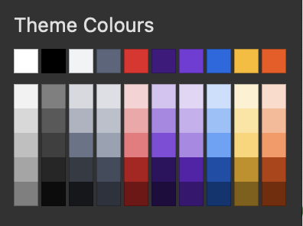
Graphics: Color, cards and lines
How we use them to create order and hierarchy
Lines are only for connections
No partner or customer logos/icons. We use generic icons to communicate the functionality they bring to the solution diagram
Equinix products and services are always in black
Use numbered markers when longer explanations are required
Non-specific elements in gray
Geography, data center or other
1
2
Arial
10pt
Bold
Initial caps
SD-WAN
Network Edge
Equinix Fabric®
Microsoft Azure®
Private Cage
Fortinet SD-WAN
ExpressRoute – Sub-Bullet
Added detail, square bullets
Customer Deployment
Arial
10pt
Initial caps
Always use Equinix product icons
Trademark
symbol,
if applicable
Layer 3 routing info
DELL PowerEdge® R650xs
VMware vSphere
Kubernetes
G191-H44 EGX
How we show clusters or redundancy
Partner and customer brand colors highlight the ecosystem and help differentiate
NVIDIA EGX
Nested cards for organization
Only use this color when you need to nest cards like this over a white background
For clarity, label the lines, especially if there is more than one type used
Label 1
Label 2
1
Long-form description connected to the marker, in sentence case.
2
Long-form description connected to the marker, in sentence case.
Insert footer text to add any applicable attribution statements for mentioned trademarks

Slide 4
























Icons
Equinix products
Non-specific deployment elements
Partners
Metal
Cross Connect
Meet-Me Room
Customer A
IBM Cloud®
BT
Network Edge
Metro Connect®
ISP
Applications
Microsoft Azure®
Colt
Precision Time
Fiber Connect
NSP
AI
Alibaba Cloud
Lumen
Equinix Fabric®
Secure Cabinet
HQ
Firewall
Oracle Cloud®
AT&T
Fabric Cloud Router
Secure Cabinet Express
SD-WAN
Switch
Google Cloud™
Telstra
WAN
Router
Cisco Webex®
Verizon
Cross Connect, Fiber Connect and Metro Connect use the same icon
Secure Cabinet and Secure Cabinet Express use the same icon
Use the ® for Equinix Fabric when in full. No ® is needed for Fabric only
Internet Access
Data Center
Virtual Device
SAP
AWS®
Internet Exchange
Remote Sites
Hardware
Zayo Group
Salesforce
Private Cage
Internet Access
Compute
Cloud Providers
Users
Load Balancing
Firewall
Storage
Cooling Distribution Unit
Icon bar height = 0.33” for all products, non-specific elements and partner bars
For more icons, visit the Equinix Brand Center.

Slide 5
Products and sub-products
The black bar is an orderable Equinix product or sub-product
Bullets are orderable Equinix sub-products
Fabric
Fabric
Examples
Metal
Redundant 10 Gbps Connections
Network Edge
Network Edge deployment in a use case example could show generic virtual devices
Private Cage
Fabric
Virtual Router
Virtual Firewall
Virtual SD-WAN
You can use the short product name without the word “Equinix” if the full name appears in multiple locations, or if space is limited
Internet Access on Fabric
Network Edge on Fabric
Network Edge
Network Edge deployment for a specific customer solution would identify the device names
Secure Cabinet Express
Network Edge
Cisco Catalyst 8000V Edge Router
Palo Alto Networks Prisma SD-WAN
Fabric Cloud Router
Cisco Catalyst 8000V Edge Router
Palo Alto Networks Prisma SD-WAN
The FCR icon is unique and does not use the Fabric icon
When using these boxes on white background, remember to turn them light gray

Slide 6

Products: Colocation
Increase the level of detail as needed
London
London
London
Secure Cabinet
Secure Cabinet
Secure Cabinet
Fabric
Customer Deployment
10 Gbps Fabric Port, Redundant
Customer Deployment
10 Gbps Fabric Port, Redundant
Fabric
Internet Access
Internet Access
Internet Access
Equinix Fabric®
Direct Configuration with Equinix-Assigned IP Addresses
Equinix Fabric®
Equinix Fabric®

Slide 7

Choose the appropriate level of detail for each diagram element
Increase the level of detail as needed
London
London
London
London
Private Cage
Private Cage
Private Cage
Private Cage
Customer Deployment
Private Cloud
Customer Deployment
Dell Hardware
VMware Hypervisor
Container Engine
Customer Deployment
DELL PowerEdge® R650xs
VMware vSphere
Kubernetes

Slide 8
Partner products and cloud service providers
Cloud-neutral storage products
Future products
Cloud services
Metal
Metal
IBM Cloud®
Cloud services can be featured at the top level with the color aligned to their logo
NetApp Storage on Metal
Observability as a Service on Metal
AWS
Metal
Direct Connect – Region
Dell PowerStore® on Metal
Colt
You can also list their product names as bullets
Metal
Colt OnDemand
VMware Cloud Foundation (VCF) on Metal
BT
MPLS

Slide 9
Grouping
Grouping
Level 2
Level 3
Level 4

Slide 10
Lines
Default lines
Additional networking information
Physical and virtual connections
Line variation
Suggestions for interconnection lines
Virtual Interconnection
Use whichever lines work for the diagram, if usage is consistent within the diagram AND you include a legend below the diagram so others will understand
Physical Interconnection
Longer-Distance Physical Interconnection
Physical Interconnection, Redundant
Virtual Interconnection, Redundant

Slide 11
Before and after: Formatting examples

Slide 12
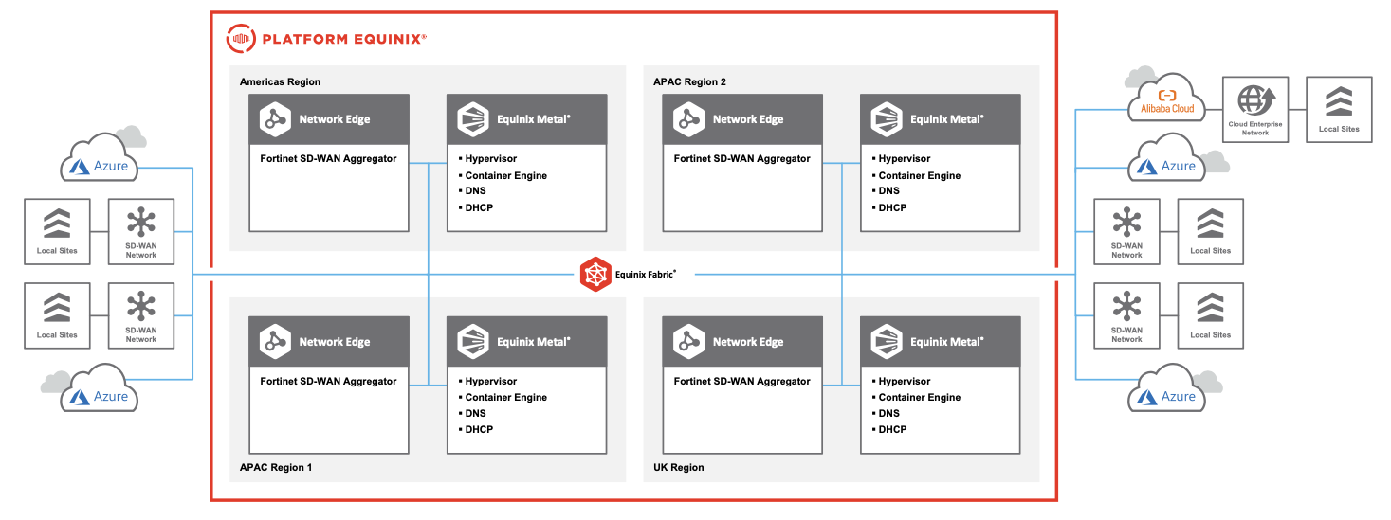
Example 1: Digital services solution
Original

Slide 13
Example 1: Digital services solution
Local Sites
Updated
Cloud Enterprise Network
Alibaba Cloud
Microsoft Azure®
AMER: USA
APAC: Singapore
Enterprise Network
ExpressRoute – Region
Network Edge
Customer Cage
Network Edge
Customer Cage
Microsoft Azure®
Fortinet SD-WAN Aggregator
Fortinet SD-WAN Aggregator
Fortinet Fortigate Secure SD-WAN
Fortinet Fortigate Secure SD-WAN
ExpressRoute – Region
Local Sites
SD-WAN
Local Sites
Fabric
Local Sites
APAC: Australia
EMEA: UK
SD-WAN
SD-WAN
Network Edge
Customer Cage
Network Edge
Customer Cage
Local Sites
Fortinet SD-WAN Aggregator
Fortinet SD-WAN Aggregator
Fortinet Fortigate Secure SD-WAN
Fortinet Fortigate Secure SD-WAN
Microsoft Azure®
SD-WAN
ExpressRoute – Region
Microsoft Azure®
Network Service
Equinix Fabric®
ExpressRoute – Region

Slide 14
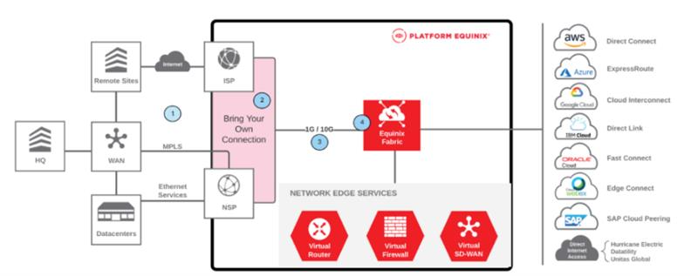
Example 2: Digital services solution
Original

Slide 15
Example 2: Digital services solution
AWS®
Oracle Cloud®
Direct Connect – Region
Fast Connect – Region
Bring Your Own Connection
1G / 10G
Fabric
Azure®
Cisco Webex®
Remote Sites
Internet
ISP
ExpressRoute – Region
Edge Connect – Region
Network Edge
HQ
WAN
MPLS
Cisco Catalyst 8000V Edge Router
F5 Networks NGINX Plus Load Balancer
Check Point CloudGuard Network Security
Google Cloud™
SAP
Cloud Interconnect – Region
Cloud Peering – Region
Ethernet Services
Data Centers
NSP
IBM Cloud®
Internet Access
Direct Link – Region
Hurricane Electric
Datability
Unitas Global
Equinix Fabric®
Network Service

Slide 16
Example 2: Digital services solution (alternative representation)
Updated alternative
Cloud Providers
AWS® Direct Connect
Azure® ExpressRoute
SAP Cloud Peering
Google Cloud™ Cloud Interconnect
Oracle Cloud® Fast Connect
IBM Cloud® Direct Link
Cisco Webex® Edge Connect
Bring Your Own Connection
1G / 10G
Fabric
Remote Sites
Internet
ISP
Network Edge
MPLS
Cisco Catalyst 8000V Edge Router
F5 Networks NGINX Plus Load Balancer
Check Point CloudGuard Network Security
HQ
WAN
Ethernet Services
Internet Access
Data Centers
NSP
Hurricane Electric
Datability
Unitas Global
Equinix Fabric®
Network Service

Slide 17
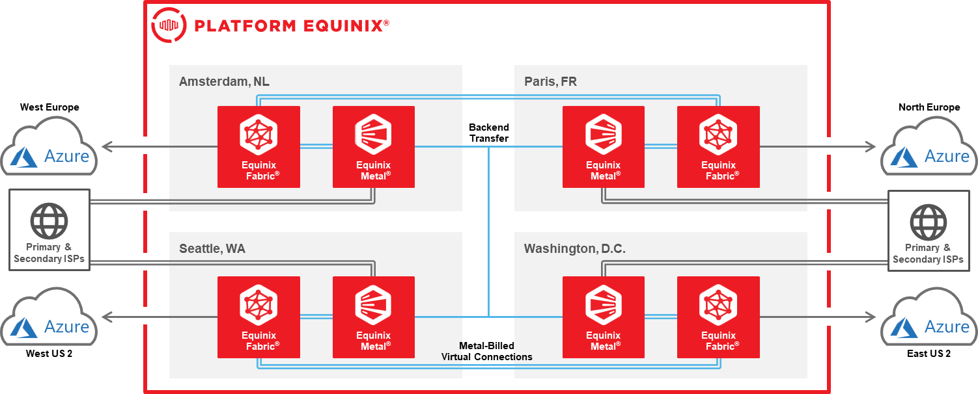
Example 3: Digital services solution
Original

Slide 18
Example 3: Digital services solution
Updated
Amsterdam, NL
Paris, FR
Microsoft Azure®
Back-End Transfer
Microsoft Azure®
ExpressRoute – West Europe
Fabric
Metal
Metal
Fabric
ExpressRoute – North Europe
ISPs
ISPs
Seattle, WA
Washington, D.C.
Microsoft Azure®
Fabric
Metal
Metal
Fabric
Microsoft Azure®
ExpressRoute – West US 2
ExpressRoute – East US 2
Metal-Billed Virtual Connections
Equinix Fabric®
Equinix Fabric®, Redundant
Interconnection, Redundant

Slide 19
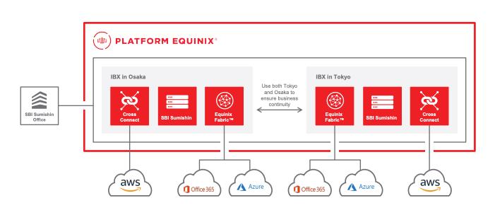
Example 4: Colocation with Fabric & interconnection
Original

Slide 20
Example 4: Colocation with Fabric and interconnection
Correct
IBX® in Osaka
IBX® in Tokyo
Customer A Office
Customer A
Customer A
Office 365®
Customer uses both Tokyo and Osaka to ensure business continuity across multiple regions
Cross Connect
Cross Connect
Azure®
Fabric
Fabric
AWS®
AWS®
Office 365®
Azure®
Equinix Fabric®
Network Service

Slide 21
Example 4: Colocation with Fabric and interconnection
Incorrect
Descriptive copy does not belong “in” the diagram
Lines are not straight
IBX® in Osaka
IBX® in Tokyo
Original diagram should have shown how the cross connects and Fabric connected
Use both Tokyo and Osaka to ensure business continuity
Cross Connect
Cross Connect
Customer A Office
Customer A
Customer A
Fabric
Fabric
Icons off center
AWS®
Office 365®
Azure®
Detail from original not preserved. We should be showing multiple instances of some cloud services

Slide 22
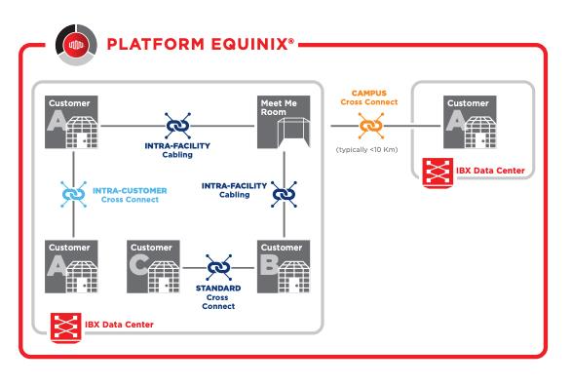
Example 5: Colocation cage with interconnection
Original

Slide 23
Example 5: Colocation cage with interconnection
Correct
IBX® Data Center A
IBX® Data Center B
1
Private Cage
Cross Connect
Meet-Me Room
Cross Connect
1
Private Cage
Intra-Facility Cable (IFC)
Campus Cross Connect
Cross Connect
Cross Connect
Private Cage
1
2
Private Cage
Cross Connect
3
Private Cage
1
Customer connecting to its own cages in different locations in the data center or campus.
When you only have one line type, or if you require a long-form explanation, you can use numbers. Use sentence case for long or sentence-like text
2
3
Customer connecting to other customers’ cages in the same data center.

Slide 24
Example 6: Colocation cage with interconnection
Correct
IBX® Data Center A
IBX® Data Center B
1
1
Private Cage
Meet-Me Room
Private Cage
Private Cage
1
2
Private Cage
3
Private Cage
1
Customer connecting to its own cages in different locations in the data center or campus.
Standard Cross Connect
2
3
Customer connecting to other customers’ cages in the same data center.
Campus Cross Connect (Typically <10 km)

Slide 25
Example 6: Colocation cage with interconnection
Incorrect
Using different colors can look confusing and it is best to avoid this where possible
IBX® Data Center
IBX® Data Center
Customer A
Meet-Me Room
Customer A
Customer A
Customer C
Customer B
Intra-Customer Cross Connect
Intra-Facility Cabling
Standard Cross Connect
Campus Cross Connect (Typically <10 km)

Slide 26
More formatting examples

Slide 27
Formatting examples
Correct
Incorrect
Amsterdam, NL
Amsterdam, NL
Fabric
Microsoft Azure®
Fabric
Microsoft Azure®
Fabric Cloud Router
Redundant 10 Gbps Connections
ExpressRoute
Azure Service A
Azure Service B
Fabric Cloud Router
ExpressRoute
Azure Service A
Azure Service B
2x
AWS®
AWS®
Equinix Fabric®
Direct Connect
AWS Service A
AWS Service B
Direct Connect
AWS Service A
AWS Service B

Slide 28
Formatting examples
Correct
Correct
Amsterdam, NL
Amsterdam, NL
Fabric
Microsoft Azure®
Fabric
Microsoft Azure®
Fabric Cloud Router
Redundant 10 Gbps Connections
ExpressRoute
Azure Service A
Azure Service B
Fabric Cloud Router
Redundant 10 Gbps Connections
ExpressRoute
Azure Service A
Azure Service B
AWS®
AWS®
Equinix Fabric®
Direct Connect
AWS Service A
AWS Service B
Equinix Fabric®
Direct Connect
AWS Service A
AWS Service B
If you need to show redundancy, show it by using the double-line line type

Slide 29
Formatting examples
Correct
Private Cage
Customer Deployment
Microsoft Azure®
DELL PowerEdge® R650xs
VMware vSphere
Kubernetes
ExpressRoute
Cloud Services
Oracle Cloud®
NVIDIA EGX
FastConnect
Exadata Service
G191-H44 EGX

Slide 30
Formatting examples
Correct
London, UK
Singapore
Metal
Colt
Fabric Cloud Router
Colt OnDemand
Private Cage
Fabric
Microsoft Azure®
25 Gbps Connection
ExpressRoute
Cloud Services
Customer Deployment
Equinix Fabric®
Network Service

Slide 31
Formatting examples
Correct
London, UK
Singapore
Metal
Colt
Private Cage
Microsoft Azure®
Widening cards to fit content is okay
Private Cloud (Customer’s) – Server Size M – Hypervisor VMware vSphere – K8 Kubernetes
Colt OnDemand
Private Cloud – DELL XYZ – Hypervisor – Container Engine
Equinix Fabric® Port
ExpressRoute
Azure Service A
Azure Service B
VLAN 1002, 1003
Equinix Fabric®
Network Service

Slide 32
Formatting examples: Multipoint-to-multipoint (MP2MP) networks: IP-WAN (layout A)
Singapore
Seoul
Private Cage
Fabric Cloud Router
Fabric
Fabric Cloud Router
Network Edge
Microsoft Azure®
Private Cloud (Customer’s)
Equinix Fabric® Port
IP-WAN
Virtual Router
ExpressRoute
Sydney
Hong Kong
Fabric Cloud Router
Metal
Metal
Fabric Cloud Router
Private Cloud
Private Cloud (Customer’s)
Equinix Fabric®

Slide 33
Formatting examples: Multipoint-to-multipoint (MP2MP) networks: IP-WAN (layout B)
Singapore
Seoul
Fabric Cloud Router
Fabric
Fabric Cloud Router
Private Cage
IP-WAN
Network Edge
Microsoft Azure®
Private Cloud (Customer’s)
Equinix Fabric® Port
Virtual Router
ExpressRoute
Sydney
Hong Kong
Fabric Cloud Router
Fabric Cloud Router
Metal
Metal
Private Cloud (Customer’s)
Private Cloud (Customer’s)
Equinix Fabric®

Slide 34
Formatting examples: Multipoint-to-multipoint (MP2MP) networks: EP-LAN
London
Warsaw
Private Cage
Fabric
Secure Cabinet
Equinix Fabric® Port EPL
EP-LAN
Equinix Fabric® Port EPL
Madrid
Secure Cabinet
Equinix Fabric® Port EPL
Equinix Fabric®

